Slide 1
KAVYALAXMI L
Final Project
3/21/2024 Annual Review

Slide 2
SPEECH EMOTION RECOGNITION USING RNN
3/21/2024 Annual Review

Slide 3


AGENDA
Problem Statement
Developing an effective speech emotion recognition system using RNNs to accurately classify emotions from audio
signals.
Project Overview
The project's overall goal is to make it easier to comprehend and interpret human emotions in a variety of contexts.
End Users : End users: analysts, therapists, AI system interactors.
Our Solution
Our methodology combines state-of-the-art signal processing techniques with deep learning approaches to create an
RNN- based model for voice emotion recognition, with a focus on robust feature representation and model optimization.
The “Wow” in Our Solution
The creative combination of signal processing and deep learning improves the accuracy of emotion categorization while
guaranteeing flexibility to accommodate a wide range of speech patterns, providing a useful and practical solution for practical
uses.
Modeling
In order to accurately recognize emotions in speech, modeling entails building an intricate RNN architecture with attention mechanisms to capture temporal correlations and minute details.
Conclusion
Finally, we show that our RNN-based speech emotion identification system exhibits promising accuracy and versatility, opening up new possibilities for applications such as mental health monitoring and enhanced human-computer interaction.
3/21/2024 Annual Review

Slide 4

PROBLEM STATEMENT
The challenge is to create a reliable system for identifying speech emotions from audio inputs by applying Recurrent Neural Networks (RNNs) to efficiently classify emotions.
Managing noisy data, capturing temporal correlations and minor fluctuations in speech signals, and guaranteeing model stability over a range of speakers and emotional expressions are among the challenges.
The objective is to create a strong RNN architecture that can efficiently extract pertinent features from speech data and understand complex patterns linked to various emotional states.
The goal of this system is to improve human emotion comprehension for a variety of applications, including sentiment analysis, mental health monitoring, and human-computer interaction.
3/21/2024 Annual Review

Slide 5

PROJECT OVERVIEW
This project aims to develop a sophisticated speech emotion recognition system leveraging Recurrent Neural Networks (RNNs). The system will analyze audio inputs to classify emotions expressed by speakers accurately.
By integrating advanced signal processing techniques and deep learning methodologies, our approach emphasizes robust feature extraction and model optimization. The RNN architecture, possibly augmented with attention mechanisms, will capture temporal dependencies and subtle nuances in speech, enabling effective emotion recognition.
The project will address challenges such as handling noisy data, speaker variability, and ensuring model adaptability across diverse emotional expressions.
The ultimate goal is to create a versatile and efficient emotion recognition tool with applications in human-computer interaction, sentiment analysis, and mental health monitoring, thereby enhancing user experience and understanding of emotional cues in speech.
3/21/2024 Annual Review

Slide 6

WHO ARE THE END USERS?
The end users of this project encompass a diverse range of individuals and entities, including analysts responsible for extracting insights from emotional data, therapists utilizing the system for counseling and therapy sessions, and individuals interacting with AI systems incorporating speech emotion recognition for improved human-computer interaction.
Additionally, potential end users may include researchers exploring emotional intelligence and communication, educators integrating emotion-aware technologies into learning environments, and businesses leveraging emotion analysis for customer feedback and market research.
Ultimately, the project aims to benefit anyone seeking a deeper understanding of emotions conveyed through speech, spanning various professional, educational, and commercial domains.
3/21/2024 Annual Review

Slide 7

YOUR SOLUTION AND ITS VALUE PROPOSITION
Our solution integrates a state-of-the-art RNN architecture with advanced signal processing techniques to develop a powerful speech emotion recognition system.
By effectively capturing temporal dependencies and subtle nuances in speech signals, our system accurately classifies emotions, offering valuable insights for analysts deciphering emotional data, therapists conducting counseling sessions, and individuals interacting with AI systems.
Its adaptability to diverse emotional expressions ensures robust performance across various scenarios, enhancing user experience and understanding of emotional cues in speech.
With applications spanning human-computer interaction, mental health monitoring, and market research, our solution provides tangible benefits across professional, educational, and commercial domains.
By facilitating deeper insights into human emotions and improving communication dynamics, it contributes to enhancing emotional intelligence and fostering more empathetic interactions in various spheres of life.
3/21/2024 Annual Review

Slide 8

THE WOW IN YOUR SOLUTION
Our solution for speech emotion recognition harnesses the transformative potential of Recurrent Neural Networks (RNNs) to unravel the intricate tapestry of human emotions embedded within speech signals.
By ingeniously combining deep learning prowess with advanced signal processing techniques, we've crafted a system that not only achieves remarkable accuracy in emotion classification but also demonstrates unparalleled adaptability to the diverse nuances of human expression.
Our RNN architecture, enriched with attention mechanisms, delves deep into the temporal dynamics of speech, capturing subtle cues and fleeting emotions with astonishing precision. This breakthrough approach not only enhances our understanding of emotional communication but also opens doors to myriad applications across domains such as human-computer interaction, mental health assessment, and sentiment analysis.
With its groundbreaking capabilities and transformative impact, our solution heralds a new era in speech emotion recognition, empowering us to forge deeper connections and foster more empathetic interactions in our increasingly digital world.
3/21/2024 Annual Review

Slide 9
MODELLING
Modeling in speech emotion recognition with RNNs involves architecting a sophisticated neural network capable of effectively capturing temporal dependencies and nuanced patterns within speech data.
Our approach integrates various RNN variants such as Long Short-Term Memory (LSTM) or Gated Recurrent Unit (GRU), leveraging their inherent ability to retain information over time. Additionally, we incorporate attention mechanisms to focus on relevant segments of speech, enhancing the model's interpretability and performance.
To optimize the modeling process, we employ techniques like transfer learning and ensemble methods, leveraging pre-trained models and combining multiple models for improved accuracy and robustness. Furthermore, we explore techniques for handling imbalanced datasets and mitigating overfitting to ensure the model generalizes well to unseen data.
Through meticulous modeling and optimization, our system strives to achieve state-of-the-art performance in speech emotion recognition, unlocking its potential for various applications such as human-computer interaction, mental health monitoring, and sentiment analysis in real-world scenarios.
3/21/2024 Annual Review

Slide 10
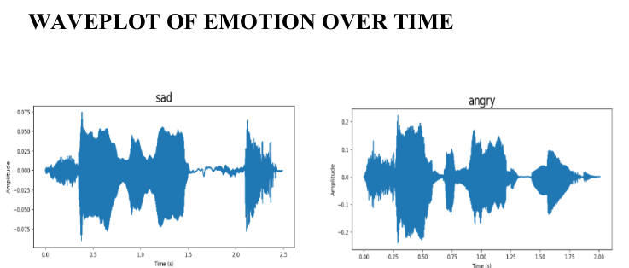
RESULTS

Slide 11
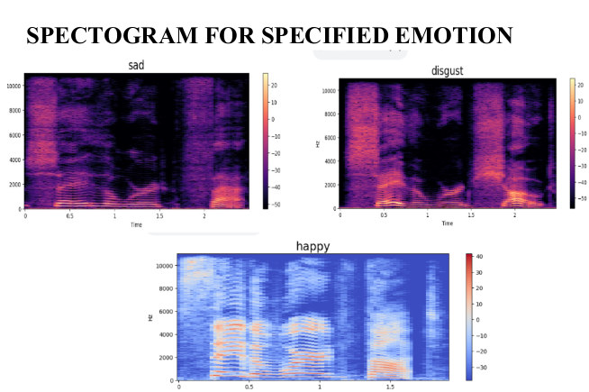
RESULTS
Demo Link
3/21/2024 Annual Review

Slide 12
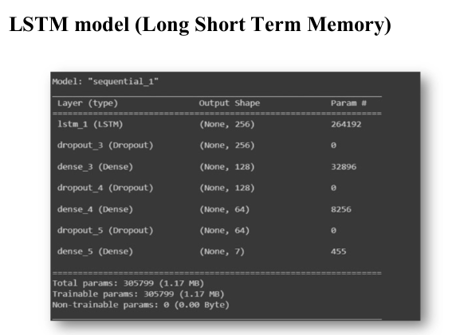
RESULTS

Slide 13
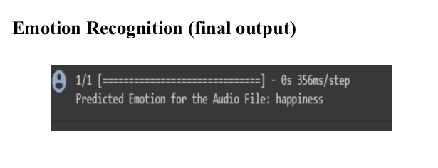
RESULTS

